Slide 1
An Update of Swine Influenza
Dr. Yogiraj Ray
Assistant Professor
Dr. Parikshit Mullick
Junior Resident
Department of Tropical Medicine
School of Tropical Medicine

Slide 2
Case
A person presented with:
  fever (temp > 100) for last 3 days
  running nose, sore throat
  Headache
  Malaise
  decreased appetite
  H/o travel to Rajasthan
  Provisional Diagnosis?

Slide 3
It may be a case of Swine flu!!
Person with fever, sore throat + 1 or more:
  Breathing difficulty
  Drowsiness
  Chest pain
  Low pressure
Children having fever, flu like illness + 1 or more:
  Breathing difficulty / ↑breathing rate
  Persistent fever
  Inability to drink/ feed
  Convulsion/ drowsiness

Slide 4
Swine flu
Influenza type A virus, strain H1N1
H1 (hemagglutinin type 1)
N1 (neuraminidase type1)
8 RNA strands from novel H1N1 flu:
  1 from human flu strains
  2 from avian (bird) strains
  5 from swine(pig) strains

Slide 5
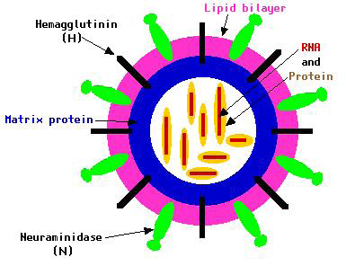

Slide 6
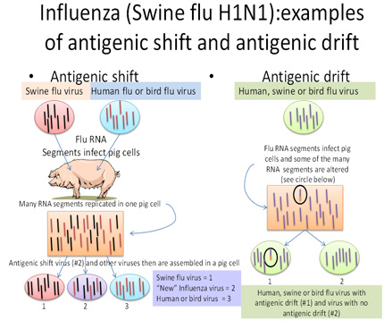

Slide 7
IP: 1.5 – 3 days (may extend to 7 days)
Transmitted by inhalational route
  Respiratory Droplet through air (<1m)
  Contact with droplet on surfaces
Infectivity period: 1 day before to 7days after symptoms
Other strains: H3N2v, H3N2, H3N1, H1N2

Slide 8
Clinical Feature
Broad spectrum of clinical manifestaion
Afebrile URTI to fulminant viral Pneumonia
Mostly infuenza like illness:
  Fever
  Cough
  Sore throat
  Rhinorrhoea
GI symptoms:
  Nausea
  Vomiting
  Diarrhoea

Slide 9
Suspected Case
Person with acute febrile respiratory illness (fever ≥ 38 ⁰ C) of recent onset:
  within 7 days of close contact with a confirmed case, or
  within 7 days of travel to community where 1 or more confirmed cases, or
  resides in a community where 1 or more confirmed cases

Slide 10
Probable case
Person with acute febrile respiratory illness who:
  positive for influenza A, but unsubtypable for H1 and H3 by influenza RT-PCR or reagents, or
  positive for influenza A by an influenza rapid test or an influenza immunofluorescence assay (IFA) + criteria for a suspected case,
  clinically compatible illness who died of an unexplained acute respiratory illness - considered to be epidemiologically linked to a probable or confirmed case

Slide 11
Diagnosis
Rapid flu test: nasal aspirate/ nasopharyngeal swab (Dacron swab); result in 30 min-2hrs
Viral culture: gold std; result in 3 to 10 days
RT-PCR Swine Flu Panel diagnostic test

Slide 12
Confirmed case
Person with an acute febrile respiratory illness with laboratory confirmed Influenza A (H1N1) virus infection at WHO approved laboratories by 1 or more of the following tests:
Real Time PCR
Viral culture
Four-fold rise in Influenza A (H1N1) virus specific neutralizing antibodies

Slide 13
Person susceptible to Swine flu
Age < 5yrs
  > 60yrs
Pregnancy
Co-morbid illness: lung ds, heart ds, CLD, CKD, blood disorders, DM, cancer, HIV
On long term immunosuppresive therapy

Slide 14
Our Next Step
Send a requisition to IDBG(with detailed history, address, phone no)
Nasopharyngeal/throat swab in VTM(collect using PPE)
(send in cold chain)
ID & BG hospital (Sister-in-charge, IB-6, 3rd fl isolation ward)NICED, Kolkata

Slide 15
Viral Transport Medium
Made available from NICED, Kolkata
Temperature kept bet 2 to 8 degree F
Sample transport maintaining Cold chain (vaccine carrier)
Along with filled lab request form:
  Name, Age, Sex
  Address, Contact no. (Mobile)
  Date of onset of fever, C/F of the pt

Slide 16
Advice to the patient
Avoid crowds, stay at home, take off from work
  Stay at least 1m away from other people
  Work from home
  Seek advice of physician over phone
Sneezing, coughing & nasal secretions - keep away from other people
  Single tissue use & dispose
  Cough etiquette
  Avoid hand shaking, touching or kissing
To join for Work only after fever subside without medication / advice of physician
Use of tri-layer surgical mask: crowded places (N-95)
Frequent Hand washing, sterilizing the nearby objects

Slide 17
How to protect ourselves in OPD
Frequent hand washing
Avoid contact with infected objects
Cough etiquette
To maintain a distance of > 1m
Use of N-95/ P-100 respirator (while clinical examination)
Use of PPE kit while collecting sample

Slide 18
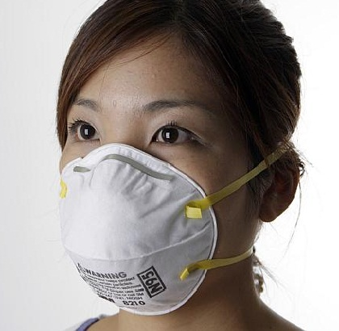
N-95 mask

Slide 19
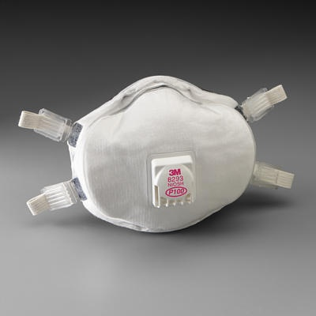
P-100 Respirator

Slide 20
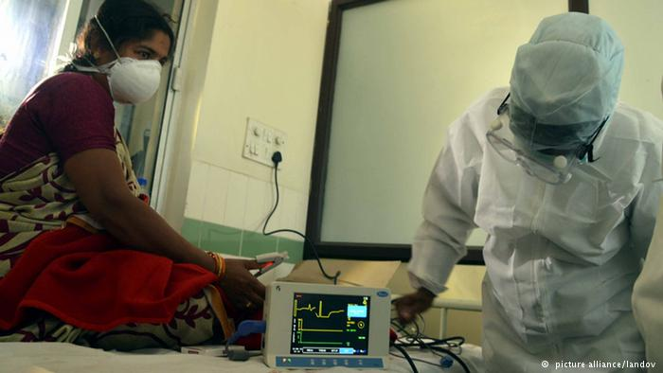

Slide 21
Personal Protection Equipment (PPE)
PPE reduces the risk of infection if used correctly. It includes:
• Gloves (nonsterile),
• Mask (high-efficiency mask) / Three layered surgical mask)
• Long-sleeved cuffed gown,
• Protective eyewear (goggles/visors/face shields),
• Cap (may be used in high risk situations where there may be increased aerosols),
• Plastic apron if splashing of blood, body fluids, excretions and secretions is anticipated

Slide 22

Personal Protection Equipment

Slide 23
Correct procedure for applying PPE in the following order
Follow thorough hand wash
Wear the coverall.
Wear the goggles/ shoe cover/and head cover in that order
Wear face mask
Wear gloves
The masks should be changed after every six to eight hours

Slide 24
Remove PPE in the following order
Remove gown (place in rubbish bin)
Remove gloves (peel from hand and discard into rubbish bin)
Use alcohol-based hand-rub or wash hands with soap and water
Remove cap and face shield (place cap in bin and if reusable place face shield in container for decontamination)
Remove mask - by grasping elastic behind ears – do not touch front of mask
Use alcohol-based hand-rub or wash hands with soap and water
Leave the room
Once outside room use alcohol hand-rub again or wash hands with soap and water

Slide 25
Influenza Epidemic and Pandemic
Epidemic – increased cases in a geographical area
Pandemic/ Outbreak – widespread / global spread
Spanish Flu (1918-1919): H1N1 20-50 million deaths worldwide; 675,000 deaths in the US. (toll more than that of first world war)
Asian Flu (1957-58): H2N2 in China in February 1957; by June 1957 spread to US; 70,000 deaths
Hong Kong Flu (1968-1969): H3N2 in Hong Kong in early 1968; later spread to US; 34,000 deaths

Slide 26
Last Pandemic
2009 Mexico: summer: younger population - high mortality
Spread to US – Europe – Worldwide
June 2009: WHO declared the first flu pandemic in 41 years
Trivalent vaccine : 2009-2010 : no virtual protection
New vaccines (live / killed virus) available in Sept. 2009-Oct. 2009

Slide 27
Last Pandemic (Cont’d)
Worldwide, 214 countries and overseas territories or communities had reported laboratory confirmed cases of pandemic influenza A (H1N1) including at least 18,449 deaths as on August 2010

Slide 28
Current Epidemic in India
Affected states: Andhra Pradesh, Gujarat, Rajasthan, Telangana, Haryana, Madhya Pradesh, Maharashtra, Punjab, Tamil Nadu and Odisha, UP, J&K, WB
Total no. of cases: 20,995
Deaths: 1115
Total no. of death in 2015 double of that in 2014

Slide 29
Case & Death Tally in India
Year | Total case reported | Total Deaths
May – Dec ’09 | 27, 236 | 981
2010 | 20, 604 | 1, 763
2011 | 603 | 75
2012 | 5, 044 | 405
2013 | 5, 253 | 699
2014 | 937 | 218
till Feb 12, 2015 | 6, 298 | 485
2015 till March 2 | 20,995 | 1115

Slide 30
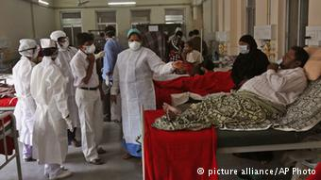

Slide 31
Epidemic in India (till 28 Feb 2015)
State | Case | Death
Rajasthan | 5,610 | 267
Gujarat | 4,614 | 275
Madhya Pradesh | 1010 | 153
Maharashtra | 1,789 | 152
Telangana |  | 57
Delhi | 2,999 | 10
Punjab |  | 42
Haryana |  | 21
karnataka |  | 46

Slide 32
Epidemic in India (till 28 Feb 2015)
State | Case | Death
West Bengal | 115 | 8
J & K |  | 7
Uttar Pradesh | 614 | 0
Andhra Pradesh |  | 12
Himachal |  | 8
Kerala |  | 7

Slide 33
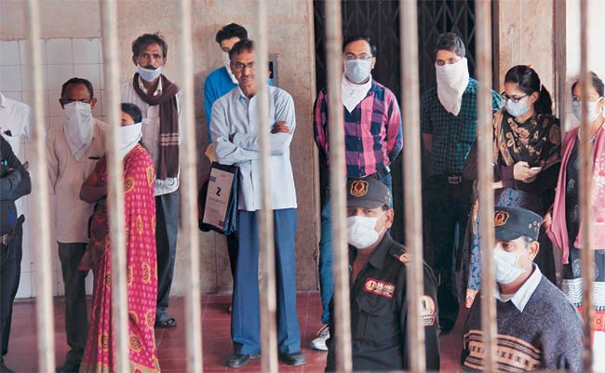

Slide 34
Category- A
Mild fever plus cough / sore throat with or without body ache, headache, diarrhoea and vomiting
Do not require Oseltamivir - Symptomatic treatment, Reassess at 24 to 48 hours
No testing for H1N1 required
Confine at home; avoid crowds, high risk members in family

Slide 35
Category-B (i)
All signs / symptoms under Category-A:
  if high grade fever + severe sore throat
  may require home isolation + Oseltamivir.

Slide 36
Category-B (ii)
All signs / symptoms under Category-A, having 1 or more high risk conditions shall be treated with Oseltamivir:
  Children with mild illness but predisposing risk factors
  Pregnant women
  Age > 65 years
  Co-morbidities: lung ds, heart ds, liver ds, kidney ds, blood disorders, diabetes, neurological disorders, cancer and HIV/AIDS
  Immunosuppressive: long term therapy

Slide 37
No tests for H1N1 required for Category-B (i) and (ii).
All patients of Category-B (i) and (ii): Confine at home; avoid crowds, high risk members in family

Slide 38
Category-C
All above signs / symptoms of Category-A and B, 1 or more of the following:
  Breathlessness, chest pain, drowsiness, fall in blood pressure, sputum mixed with blood, bluish discolouration of nails;
  Children with influenza like illness who had a severe disease as manifested by the red flag signs (Somnolence, high and persistent fever, inability to feed well, convulsions, shortness of breath, difficulty in breathing, etc).
  Worsening of underlying chronic conditions.
Require testing, immediate hospitalization, treatment

Slide 39
Treatment
Oseltamivir (TAMIFLU): oral 75mg/ 45mg/ 30mg
Zanamivir (RELENZA): inhalational 10mg (2 inhalation) BD X 5 days
Peramivir (RAPIVAB): i.v. injection (under trial)

Slide 40
Oseltamivir therapy
Dose for adults:
  > 40kg : 75mg BD X 5days
  24 – 40kg : 60mg BD X 5days
  15 – 23kg : 45mg BD X 5days
  <15kg : 30mg BD X 5days
Dose for infants:
  <3 m : 12mg BD X 5days
  3 – 5 m : 20mg BD X 5days
  6 – 11m : 25mg BD X 5days

Slide 41
Management of the Epidemic
Opening of Isolation ward (5-10 beds) in each District Hospitals & Medical Colleges
Only for tested H1N1 positive cases for treatment
To be made operational on need
Management in ID & BG Hospital, Kolkata
Only 3rd tri pregnancy H1N1 pts at NRSMCH

Slide 42
Oseltamivir chemoprophylaxis
Half of the above-mentioned dose X 10days
eg: Person > 45kg: 75mg OD X 10days
Indication:
  Health care providers
  Family members who come in close contact with confirmed cases

Slide 43
Pharmacokinetics of Oseltamivir
Neuraminidase inhibitor
Renal elimination >99% of the administered dose (both glomerular filtration and tubular secretion)
Dose adjustment reqd in renal impaired pts
Converted by hepatic esterases to its active metabolite, oseltamivir carboxylate
Neither oseltamivir nor its carboxylate: substrate or inhibitor of cytochrome P450 isoforms
No dose modification for CLD

Slide 44
Dose Adjustment for therapy
Creatinine Clearance | Treatment Regimen
Mild Creatinine Clearance >60-90 mL/min | 75 mg twice daily for 5 days
Moderate Creatinine Clearance >30-60 mL/min | 30 mg twice daily for 5 days
Severe Creatinine Clearance >10-30 mL/min | 30 mg once daily for 5 days
ESRD Patients on Hemodialysis Creatinine Clearance 10 mL/min | 30 mg after every hemodialysis cycle. Treatment duration not to exceed 5 days
ESRD Patients on Continuous Ambulatory Peritoneal Dialysis Creatinine Clearance 10 mL/min | A single 30 mg dose administered immediately after a dialysis exchange

Slide 45
Dose Adjustment for Prophylaxis
Creatinine Clearance | Treatment Regimen
Mild Creatinine Clearance >60-90 mL/min | 75 mg once daily for 10 days
Moderate Creatinine Clearance >30-60 mL/min | 30 mg once daily for 10 days
Severe Creatinine Clearance >10-30 mL/min | 30 mg every other day
ESRD Patients on Hemodialysis Creatinine Clearance 10 mL/min | 30 mg after alternate hemodialysis cycle
ESRD Patients on Continuous Ambulatory Peritoneal Dialysis Creatinine Clearance 10 mL/min | 30 mg once weekly immediately after a dialysis exchange

Slide 46
Drug Interaction with Oseltamivir
Entecavir: ↑ bd level/ effect of both
Methotrexate: ↓ renal elimination, ↑ bd level
Pemetrexed: ↑ toxicity, BM suppression; anaemia, bleeding, infection, nv damage
Ampicillin
Colchicine ↑ blood level of Oseltamivir
Probenicid (by ↓ its renal tubular secretion)

Slide 47
Side Effect - Oseltamivir
Mostly, nausea & vomiting (mild to moderate); occur within first 2 days of treatment
Rash, swelling of the face or tongue, toxic epidermal necrolysis
Hepatitis, abnormal liver function tests
Arrhythmias
Seizures, confusion
Aggravation of diabetes

Slide 48
Pregnant Mother
Oseltamivir and zanamivir: Pregnancy Category C
Used only if - potential benefit justifies the potential risk to the embryo or fetus
No adverse effects reported yet (mother/ fetus)
Pregnancy should not be considered C.I. to oseltamivir or zanamivir use.
Oseltamivir - preferred for treatment of pregnant women (due to its systemic activity)

Slide 49
Vaccine
2009 H1N1 Flu Shot:
  Inactivated (killed virus)
  antigen derived from A/California/7/2009 (H1N1)
  Thiomersal (egg derived), formaldehyde, sucrose, sodium deoxycholate
  Usually administered in deltoid
  Single dose, i.m. (2 dose in child < 10yr / IC)
  Given in 6 m & above
  CI: allergic to egg, GB synd

Slide 50
Vaccine (Cont’d)
2009 H1N1 nasal spray flu vaccine: NASOVAC
  Live attenuated (weakened virus) vaccine
  Intranasally 0.2ml, 0.1ml in each nostril
  produces a significantly stronger immune response
  recommended only in 2–49 years of age
  2-9yrs: 2doses, 1m apart; > 10yrs: single dose
  C.I. in IC, pregnant, chronic diseases

Slide 51
Vaccine (Cont’d)
Trivalent Vaccine: INFLUVAC (Abbott) / VAXIGRIP (Sanofi Pasteur):
  inactivated purified surface fragments (sub-units)
  Against Infulenza type (A/ H1N1, A/ H3N2 & B)
  Administered deep s.c. / i.m.
  C.I. in persons allergic to egg
  Not full proof (http://www.cdc.gov/media/releases/2015/p0115-flu-vaccination.html )

Slide 52
Indications of vaccination
Pregnancy > 14wks gestation during the epidemic
Health Care providers
All people >65 years
People <65 years:
  CVS - IHD, CHF, RHD, congenital
  CVA
  Resp – Asthma, COPD
  Diabetes
  Chronic renal disease
  Any cancer (excl basal or squamous skin cancers if not invasive)
  Other - autoimmune ds, immune suppression, HIV, transplant recipients, NM and CNS ds, haemoglobinopathies

Slide 53
Time of Vaccination
Ideal time: just before monsoon (March – June)
Gives protection for 1yr
Epidemic period: susceptible persons, children, pregnant mothers, health care workers

Slide 54
Side effect of Vaccine
Common:
  Headache, Tiredness, Increased sweating, shivering, flu-like symptoms
  Fever, myalgia, arthralgia
  Pain, redness, lump, itching or bruising at the injection site
  Lymphadenopathy (cervical/ axilla/ inguinal)
Uncommon:
  Tingling or numbness of hands/ feet
  drowsiness or sleeplessness, feeling unwell, dizziness.
  Diarrhoea, vomiting, pain abdomen, feeling sick
  Rash or urticaria

Slide 55
Side effect of Vaccine (Cont’d)
Rare:
  Anaphylaxis (esp. allergic to egg)
  Seizure
  Thrombocytopenia: bleeding & bruises
Very Rare:
  Vasculitis
  Encephalomyelitis
  Neuritis
  Guillain–Barré syndrome

Slide 56
Current situation
All swine flu vaccines in India: IMPORTED
Each flu shot costs: Rs.500 – Rs.1000/-
Bharat Bio-tech, Serum Institute, Pune, and Panacea Biotech, New Delhi: to produce affordable indigenous H1N1 vaccines – NOT AVAILABLE TILL DATE
Shortage of drugs in India

Slide 57
Take Home Message
Don’t neglect the flu like symptoms in any age group
Avoid crowded places, maintain cough etiquette, stay at home
If necessary, advice with physician over phone
Throat swab testing from Govt recognised labs
Treatment with Oseltamivir in confirmed case
Vaccination for the susceptible

Slide 58
Reference
Centers for Disease Control & Prevention (CDC) www.cdc.gov
Ministry of Health & Family Welfare Influenza A (H1N1) Guidelines on categorization of Influenza A H1N1 cases
WHO guidelines: Behavioural interventions for reducing the transmission & impact of Influenza A (H1N1) Virus
The Times of India Newspaper, website www.timesofindia.com
The Anandabazar Patrika, Ebela Newspaper
The Hindu website www.thehindu.com
The Economic Times http://economictimes.indiatimes.com

Slide 59
Thank yoU
Courtesy: Prof. B. Saha, HOD, Tropical Medicine

